Slide 1
Doctor Appointment Booking System
Presented By :
[Student’s Name Here]
[Student’s Name Here]

Slide 2
INDEX
Project Overview
Scope
Modules
Development Tools
Pros & Cons
Applications

Slide 3
PROJECT OVERVIEW
The proposed project is a smart appointment booking system that provides patients or any user an easy way of booking a doctor’s appointment online. This is a web based application that overcomes the issue of managing and booking appointments according to user’s choice or demands. The task sometimes becomes very tedious for the compounder or doctor himself in manually allotting appointments for the users as per their availability. Hence this project offers an effective solution where users can view various booking slots available and select the preferred date and time. The already booked space will be marked yellow and will not be available for anyone else for the specified time. This system also allows users to cancel their booking anytime. The application uses Asp.net as a front-end and sql database as the back-end.

Slide 4
MODULES
ADMIN
  Login
  Administers Booked
  Cancellation
  View User Data
  Feedback view and reply
USER
  Register
  Login
  Book Appointment
  Cancellation
  Receipt
  Feedback
  Recharge Account

Slide 5

DEVELOPMENT TOOLS
MICROSOFT VISUAL STUDIO
Microsoft Visual Studio is an integrated development environment (IDE) from Microsoft. It is used to develop computer programs, as well as websites, web apps, web services and mobile apps. Visual Studio supports 36 different programming languages and allows the code editor and debugger to support nearly any programming language.
Features:
1. Code Editor 2. Debugger 3. Designer 4. Extensibility

Slide 6
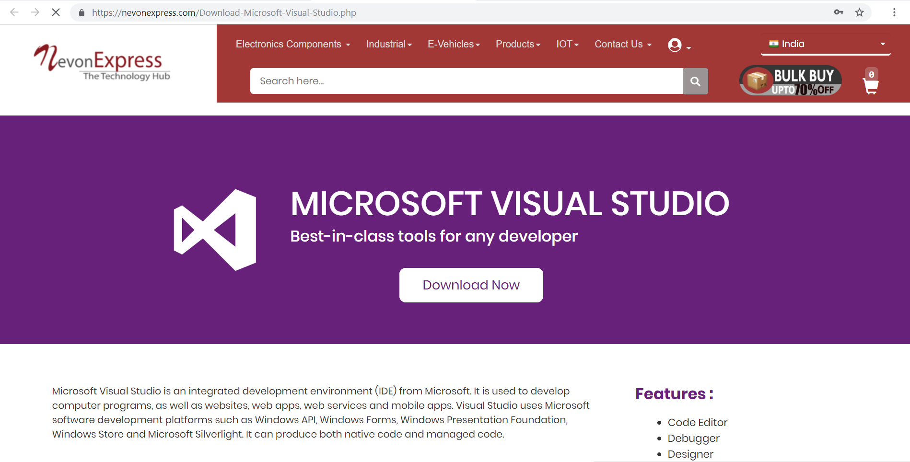
DOWNLOAD MS VISUAL STUDIO
We can get Visual Studio from NevonExpress.com : Visit Here

Slide 7

DEVELOPMENT TOOLS
MICROSOFT SQL SERVER
Microsoft SQL Server is a relational database management system developed by Microsoft. As a database server, it is a software product with the primary function of storing and retrieving data as requested by other. Microsoft markets at least a dozen different editions of Microsoft SQL Server, aimed at different audiences and for workloads.
Features:
1. Least Vulnerable 2. Advanced Analytics 3. Easy-to-Use

Slide 8
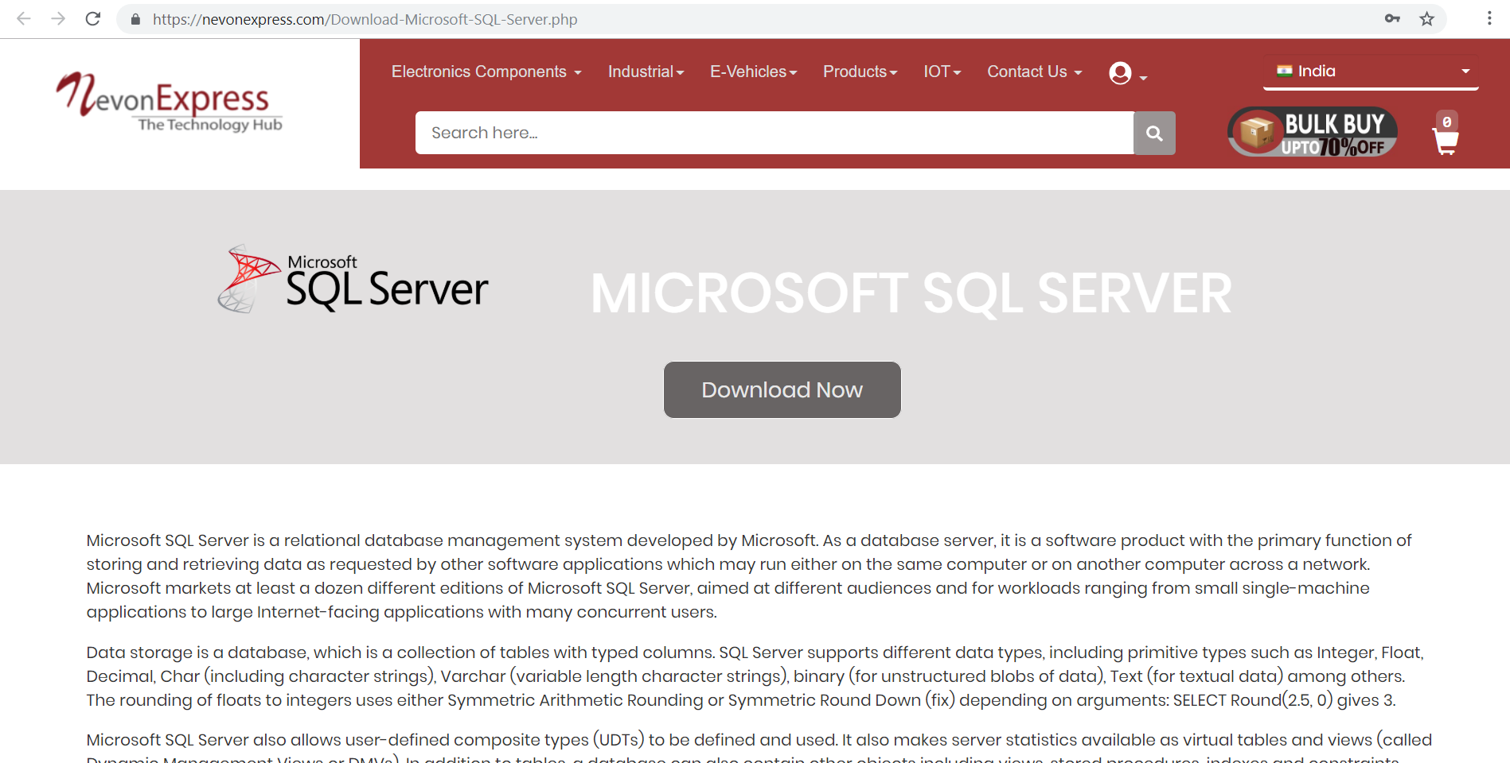
DOWNLOAD MICROSOFT SQL SERVER
We can get SQL Server from NevonExpress.com : Visit Here

Slide 9
PROS & CONS
Advantages
Disadvantages
It requires an internet connection.
It requires large database.

Slide 10
APPLICATIONS
The project can be implemented in hospitals and clinics
It can be utilized by companies and organizations (hospitals, schools, colleges) to automate their parking system.

Slide 11
THANK YOU !!!

